Slide 1
Smart Home Automation & Security System
CEIS101 Final Course Project
2024 March Session
Keith Warren
Prof. Velazquez

Slide 2
Introduction
Project Overview:
Developing a prototype of a smart home system using Tinkercad, IoT TechCore Kit, and Arduino with the Arduino IDE software.
Objectives:
Design and simulate circuits using Tinkercad.
Build and program the hardware components for real-world testing.
Implement basic and advanced features to monitor and control home environment securely.
Tools Used:
Tinkercad
IoT TechCore Kit (breadboard, wires, Arduino, LEDs, sensor, etc.)
Arduino IDE software

Slide 3
Introduction to Tinkercad Simulations
&
Hardware Components

Slide 4
CEIS101 Module 2
Circuit Simulation in Tinkercad

Slide 5
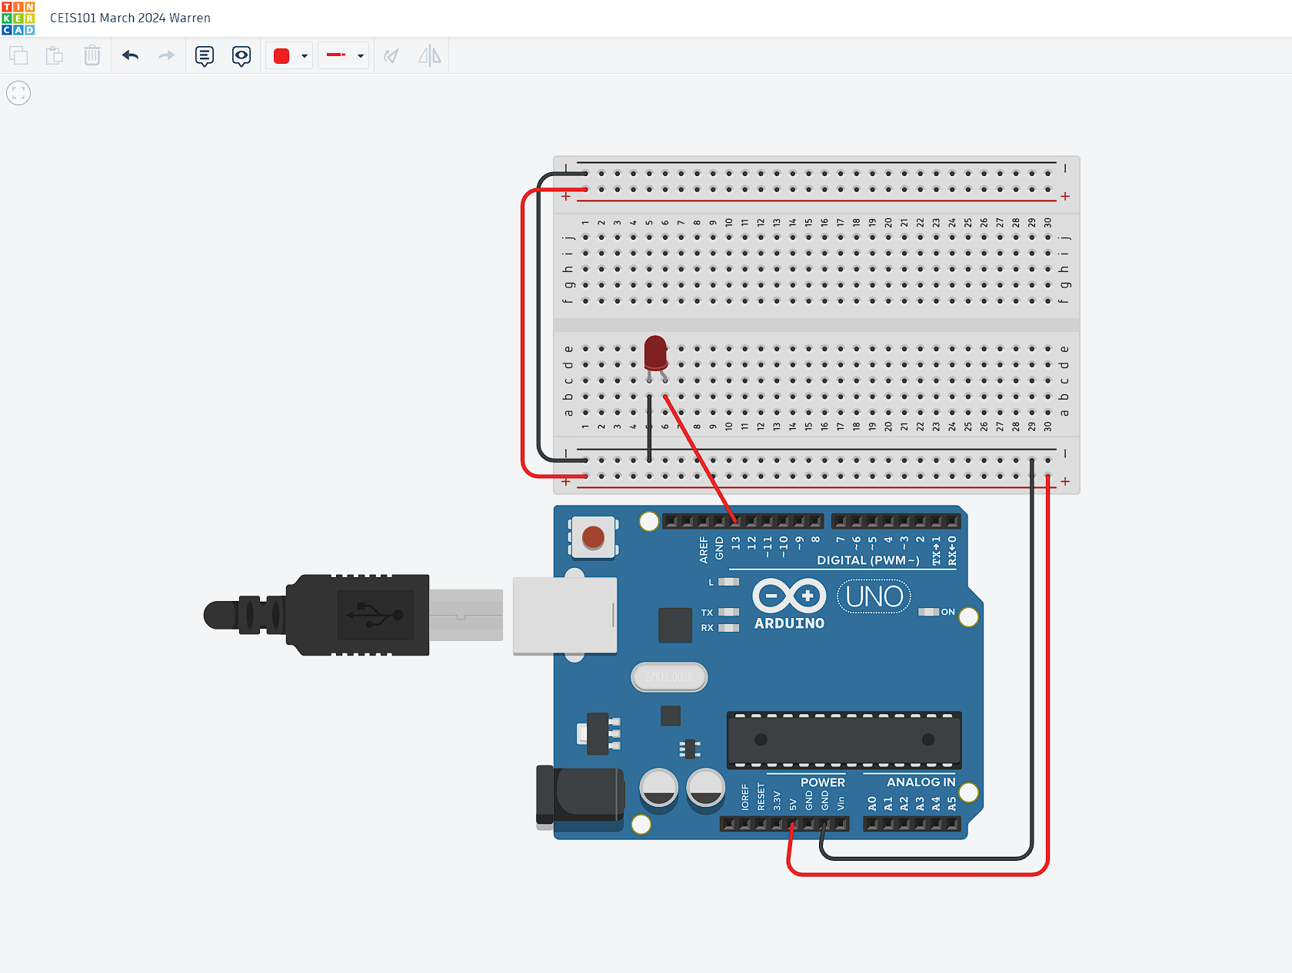
Circuit (screenshot)

Slide 6
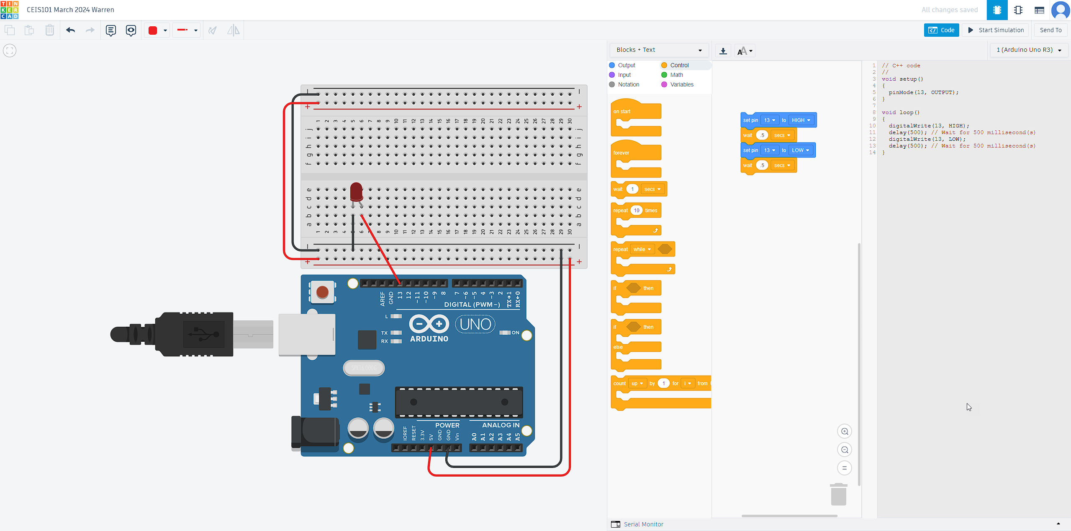
Code (screenshot)

Slide 7
Introduction to LED Circuit Building,
Using Serial Monitor Basics, and Programming

Slide 8
CEIS101 Module 3
Inventory of Parts, Circuit Building, and Displaying Messages

Slide 9
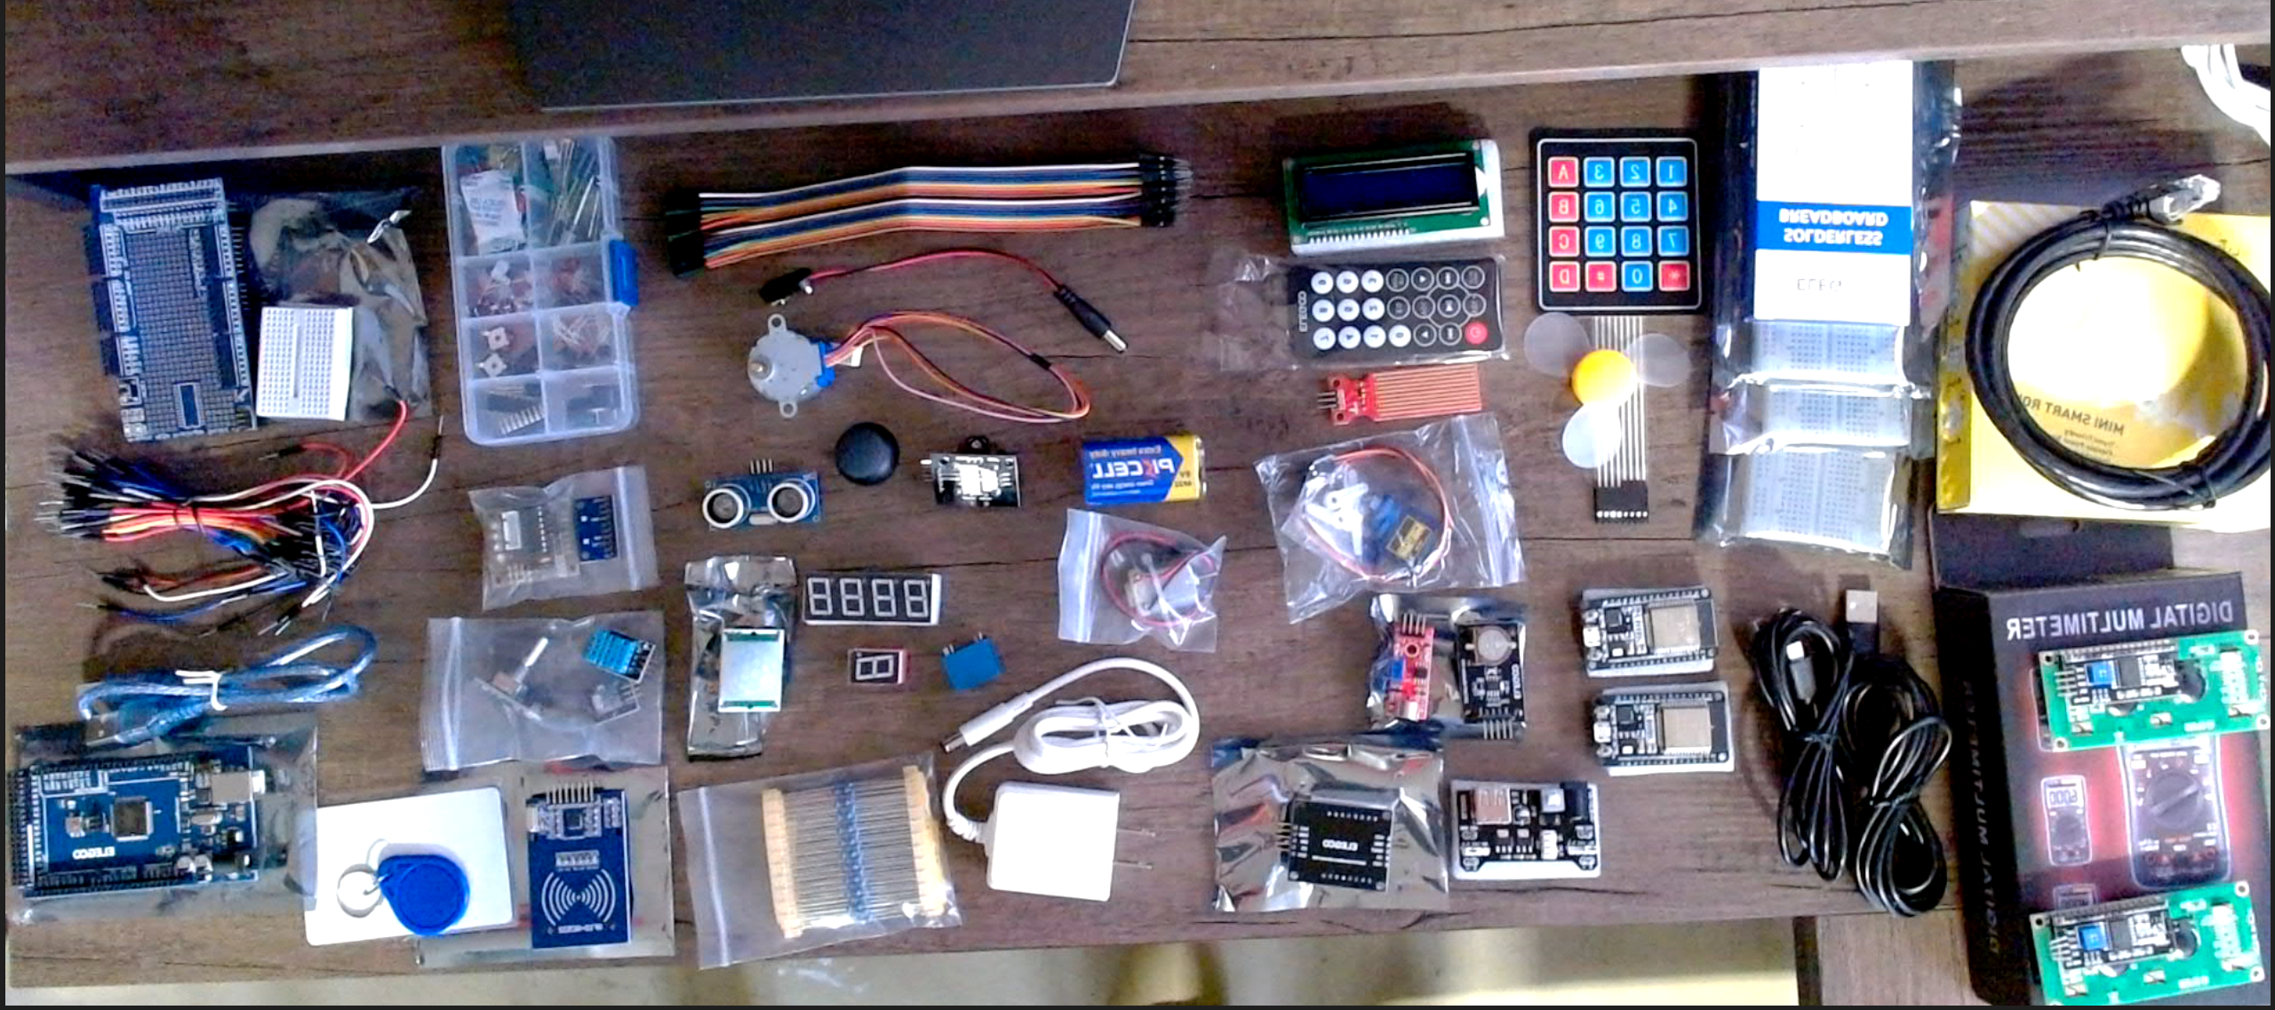
Inventory of IoT Kit (picture)
UCTRONICS Kit
ESP32 (2)
LCD Modules (2)
Breadboards (3)
Mini Router
Patch Cable
Digital Multi Meter
USB to Micro USB (2)

Slide 10
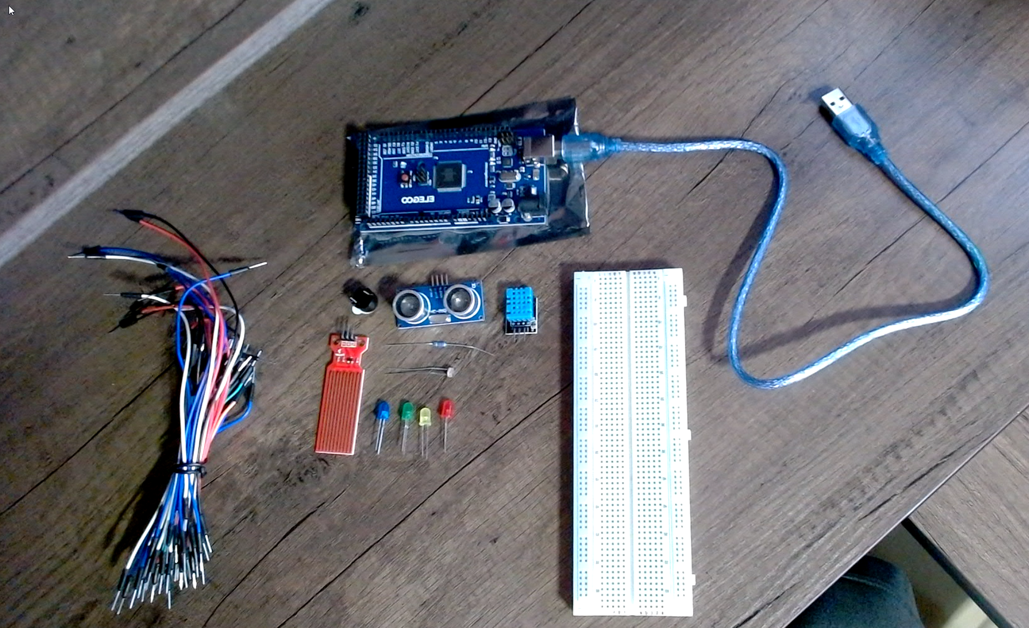
Organization of Project Components (picture)
Arduino Mega 2560
Breadboard
Resistor 10kΩ
LEDs
Ultrasonic Sensor
Active Buzzer
Photoresistor
Wires
USB Type B cable

Slide 11
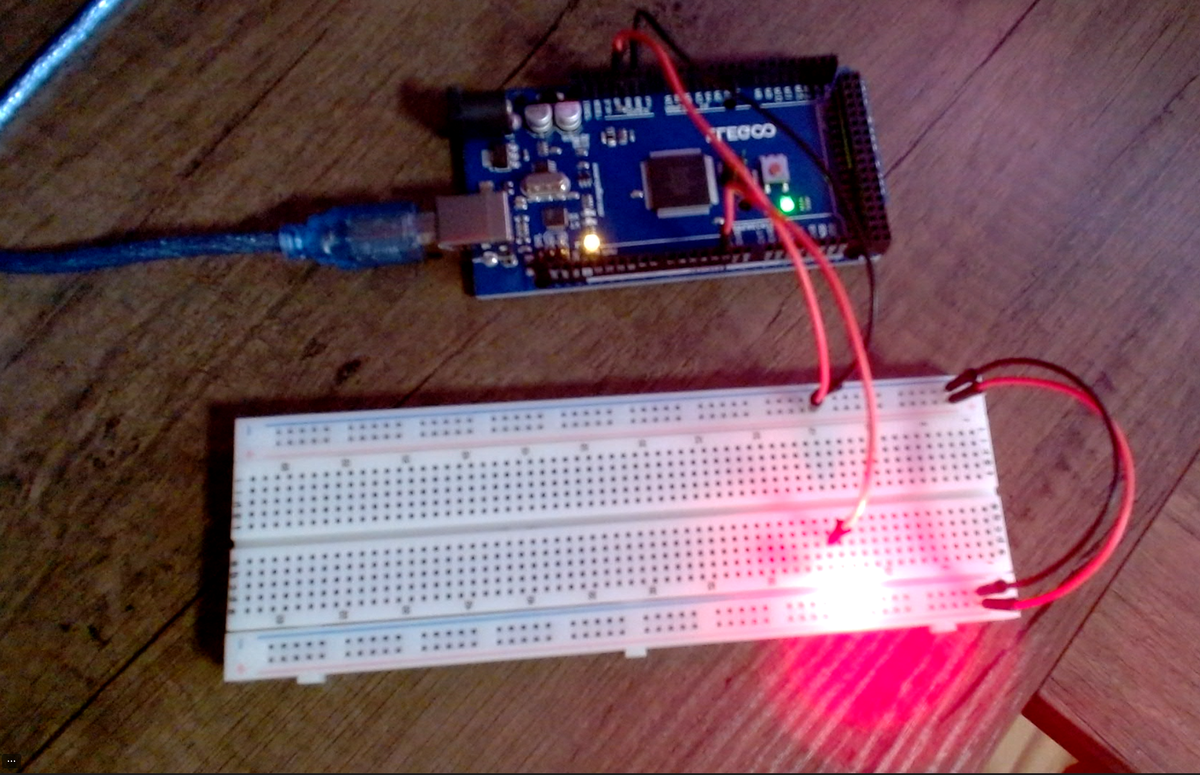
Circuit with red LED on (picture)

Slide 12
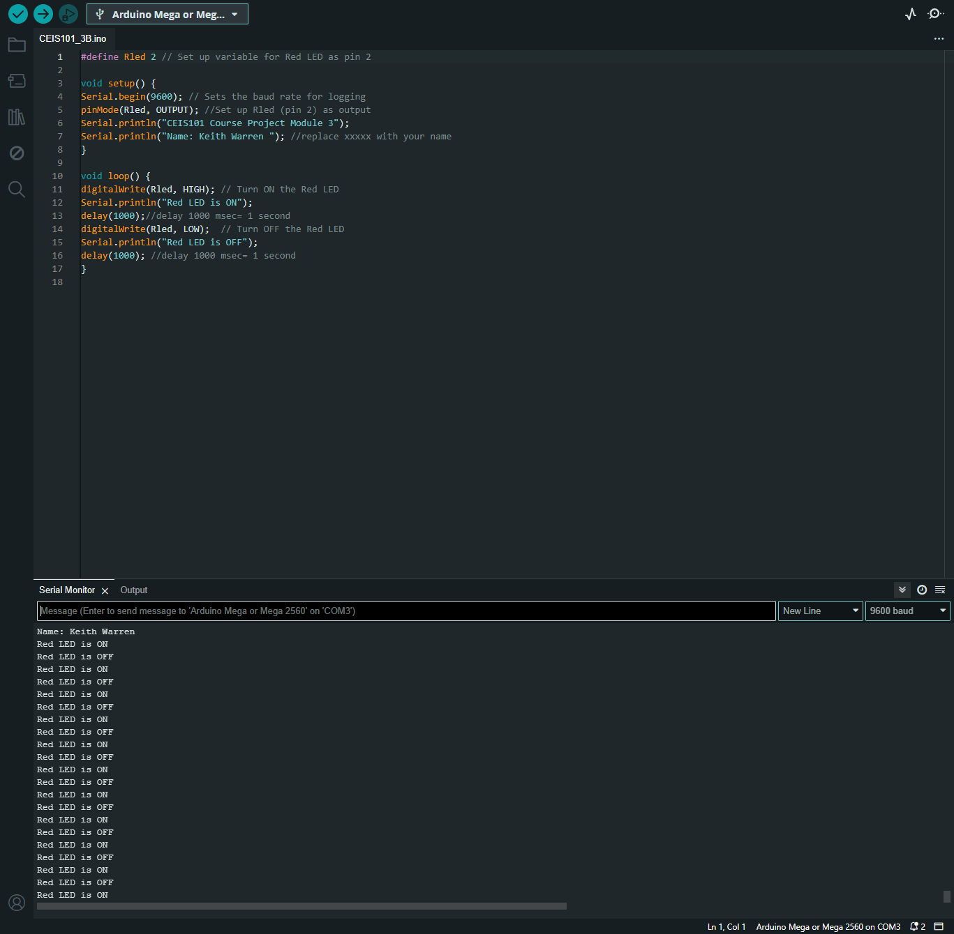
Serial Monitor (screenshot)

Slide 13
Advanced Connectivity with Arduino
&
Security Features Intergration

Slide 14
CEIS101 Module 4
Adding Door Sensor to Smart Home System

Slide 15
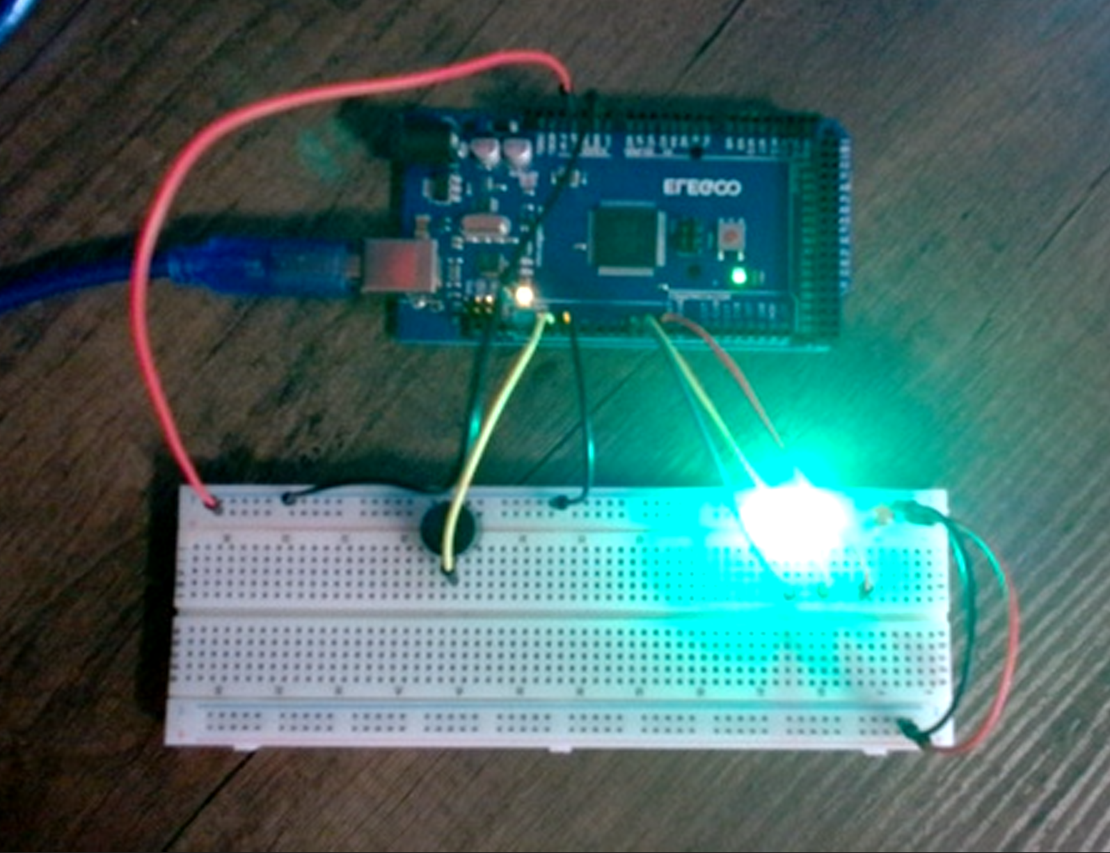
Circuit of door closed with Green LED ON (picture)

Slide 16
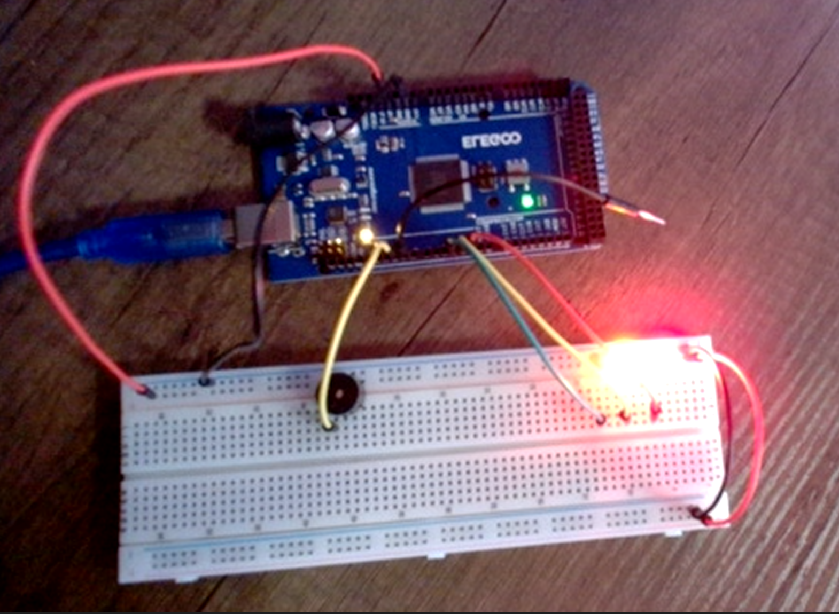
Circuit of door open with Green LED OFF (picture)

Slide 17
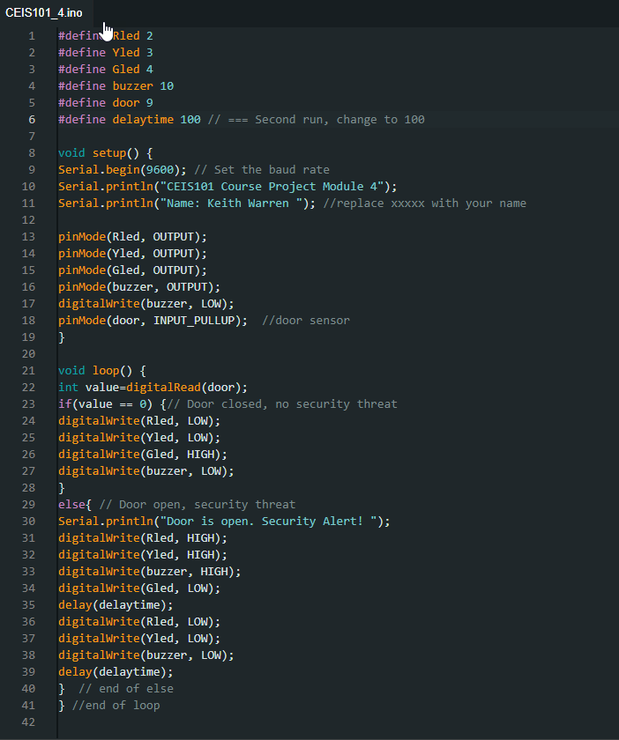
Arduino Code (screenshot)

Slide 18
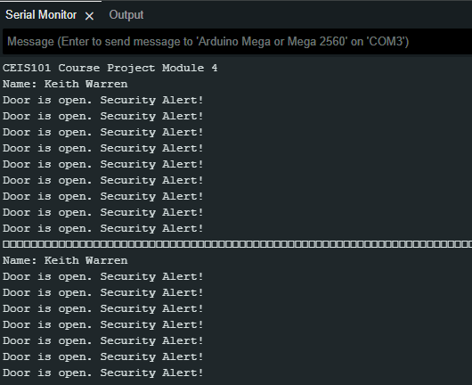
Serial Monitor (screenshot)

Slide 19
CEIS101 Module 5
Adding Distance Sensor to Smart Home System
and Conducting Data Analysis

Slide 20
Utilizing Sensors for Environment Data
&
Security Alerts

Slide 21
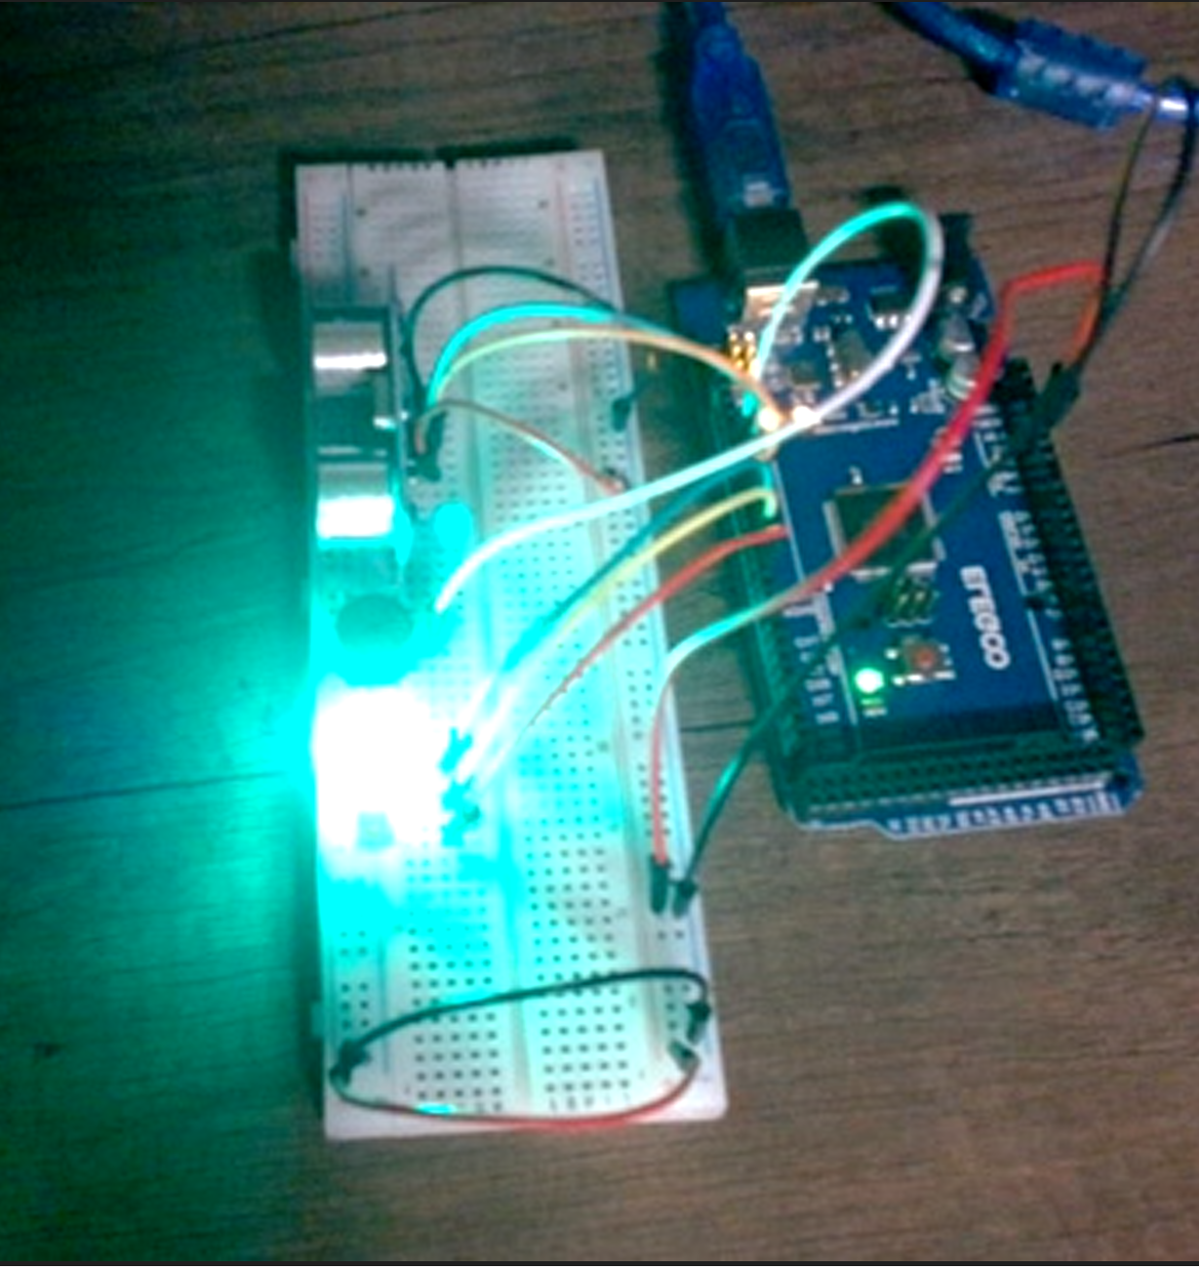
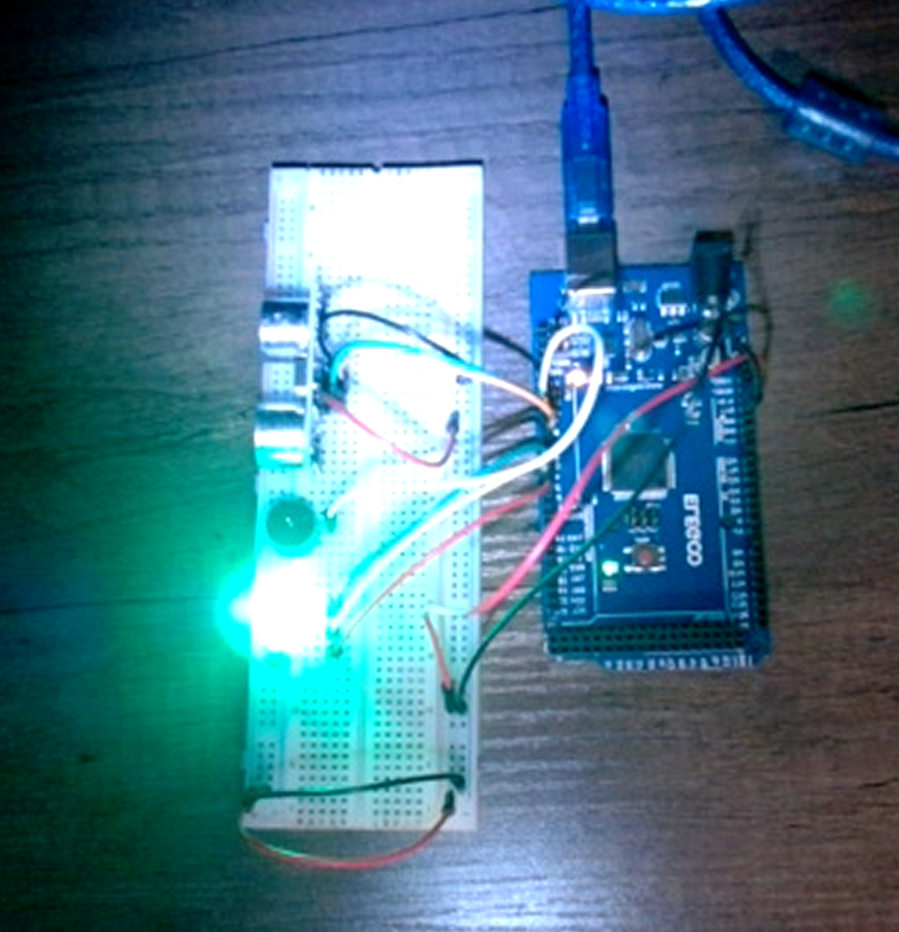
Circuit with green LED on (picture)

Slide 22
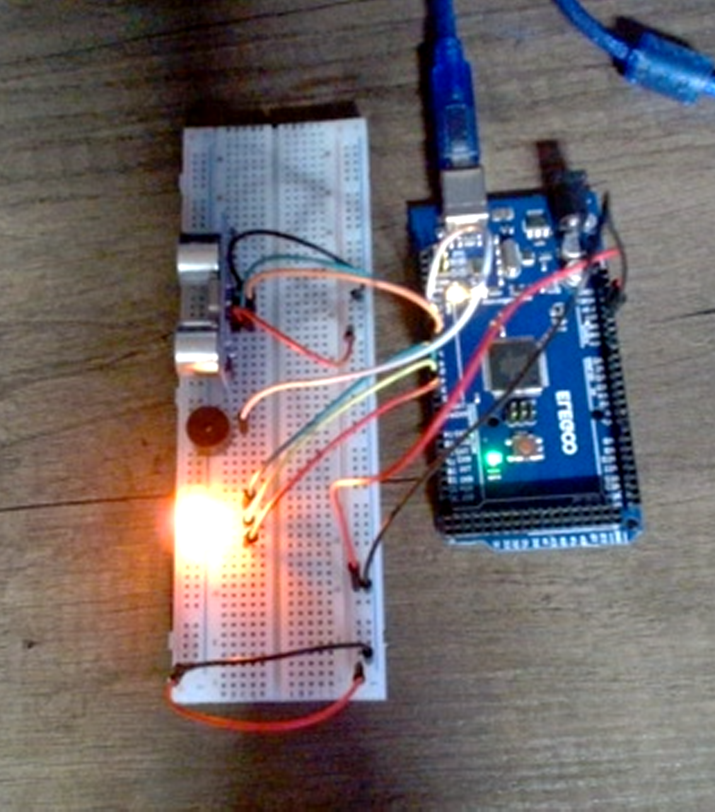
Circuit with yellow LED on (picture)

Slide 23
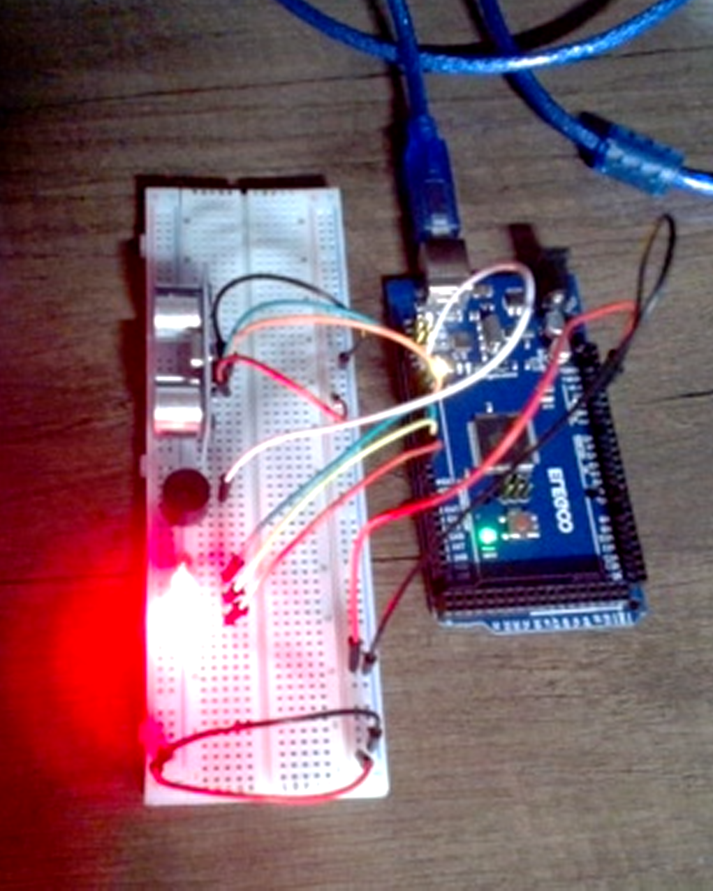
Circuit with red LED on (picture)

Slide 24
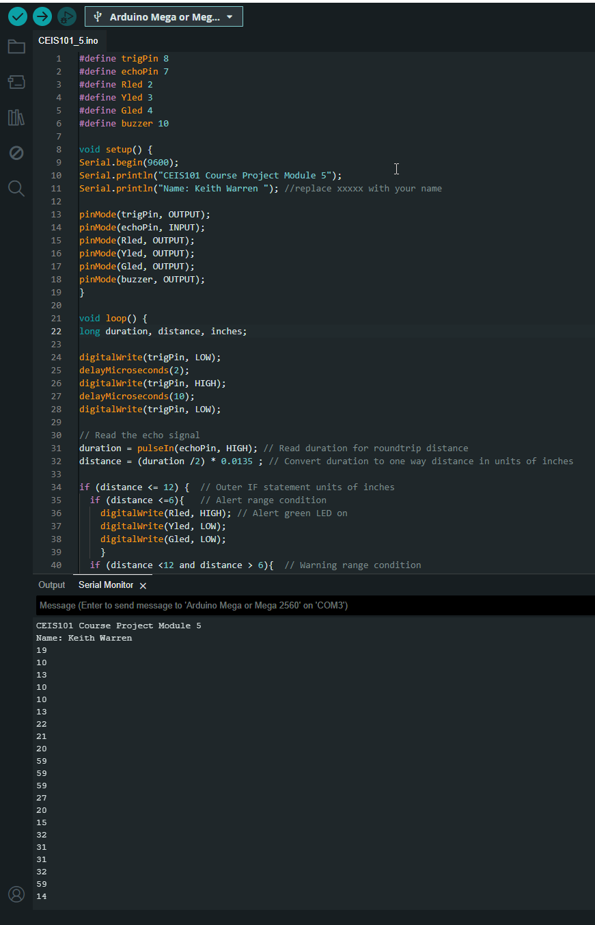
Arduino Code (screenshot)

Slide 25
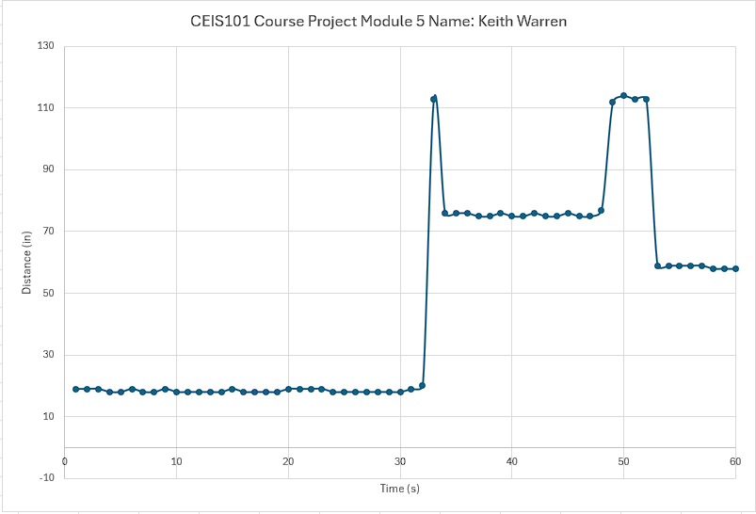
Plot of data (graph from Excel)

Slide 26
Light Sensor Applications
&
Automated Lighting Control

Slide 27
CEIS101 Module 6
Adding Automated Light to Smart Home System

Slide 28
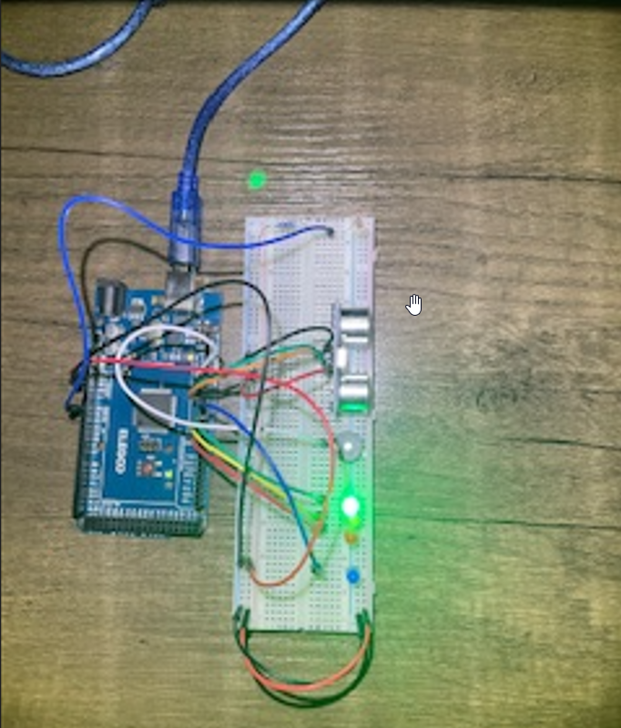
Circuit with automated LED off (picture)

Slide 29
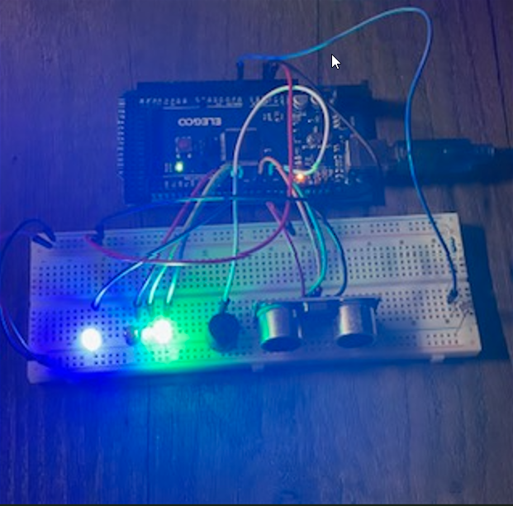
Circuit with automated LED on (picture)

Slide 30
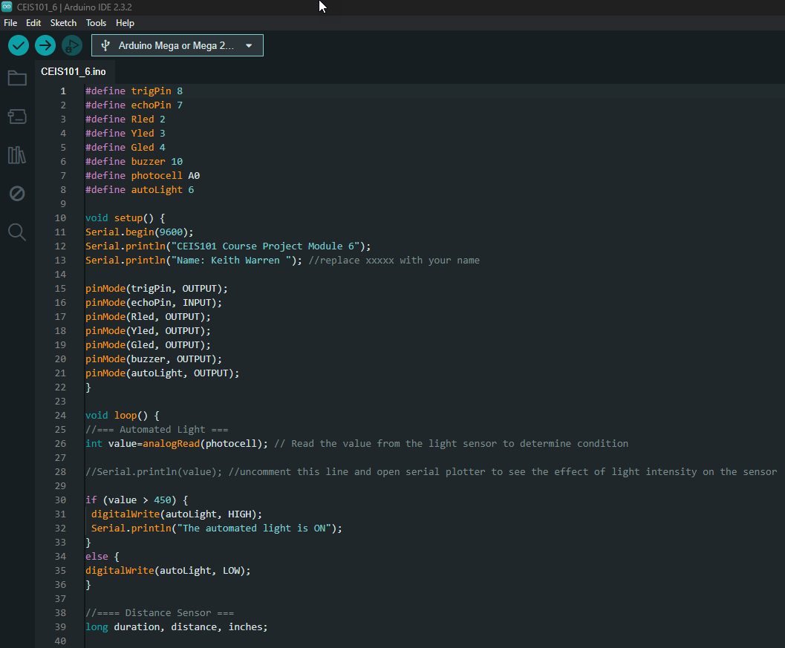
Arduino Code (screenshot)

Slide 31
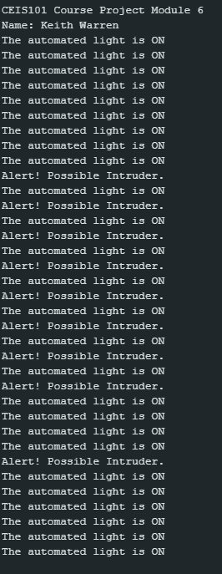
Serial Monitor (screenshot)

Slide 32
Challenges/Lessons Learned
What challenges did you face while working on the project?
How did you overcome these challenges?
What lessons did you learn?

Slide 33
Career Skills
Based on the smart home automation and security system project completed in this course Here are some of the skills and competencies I developed to help advance my career.
Skills Developed:
Analytical Skills: The ability to analyze data from sensors and to interpret the readings correctly.
Basic Programming with Arduino IDE: Being able to read, write and edit code in the Arduino IDE is a fundamental skill for IoT device programming.
Hardware Assembly: The ability to understand and put together hardware components.
Circuit Simulation and Design: Ability to simulate circuits for prototyping using Tinkercad.
Competencies to Advance Career:
Problem Solving: Being able to identify problems and develop efficient solutions.
Project Management: The capability to manage a project from the design phase to implementation.
Adaptability: Willingness to learn and adapt to new technologies and methodologies.
Creativity and Innovation: The ability to think creatively in applying technology to solve real-world issues.

Slide 34
Conclusion
In conclusion, this course culminated in the successful creation of a fully operational smart home prototype, adept at monitoring and adapting to a range of environmental conditions. My participation in this course significantly enhanced my skills in programming IoT devices and integrating complex systems.

