Slide 1
CEIS150 Course Project Stock Tracking program
2024 Sept Session Keith Warren
Prof. su

Slide 2
Introduction
Structured Programming
Object-Oriented Programming Topic three
Classes
Inheritance
Python Libraries
Files (csv)
Functional Programming and Iterators

Slide 3
Environment Setup & Structured programming – Module 1

Slide 4
Setting up environment and coding program
Installation/Setup/Tools
Created a Python Program

Slide 5
Developing Object-oriented (OOP) techniques – Module 2

Slide 6
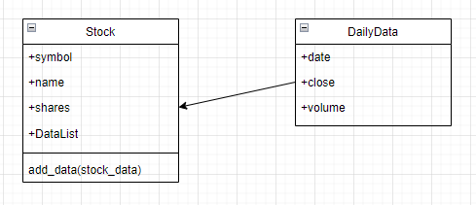
Class diagram

Slide 7
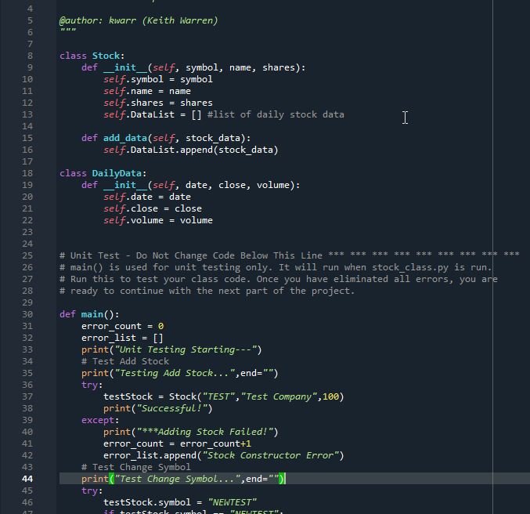
Class code

Slide 8
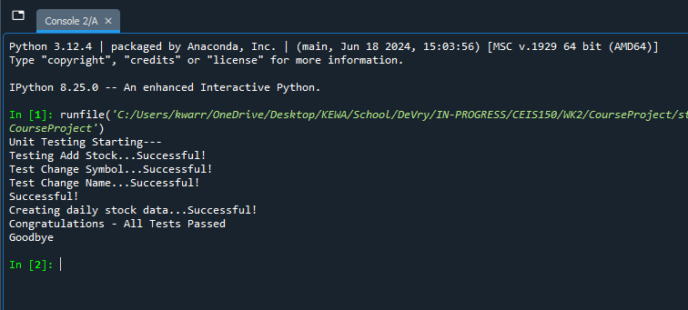
Unit test

Slide 9
Text-based User interface & summary report – Module 3

Slide 10
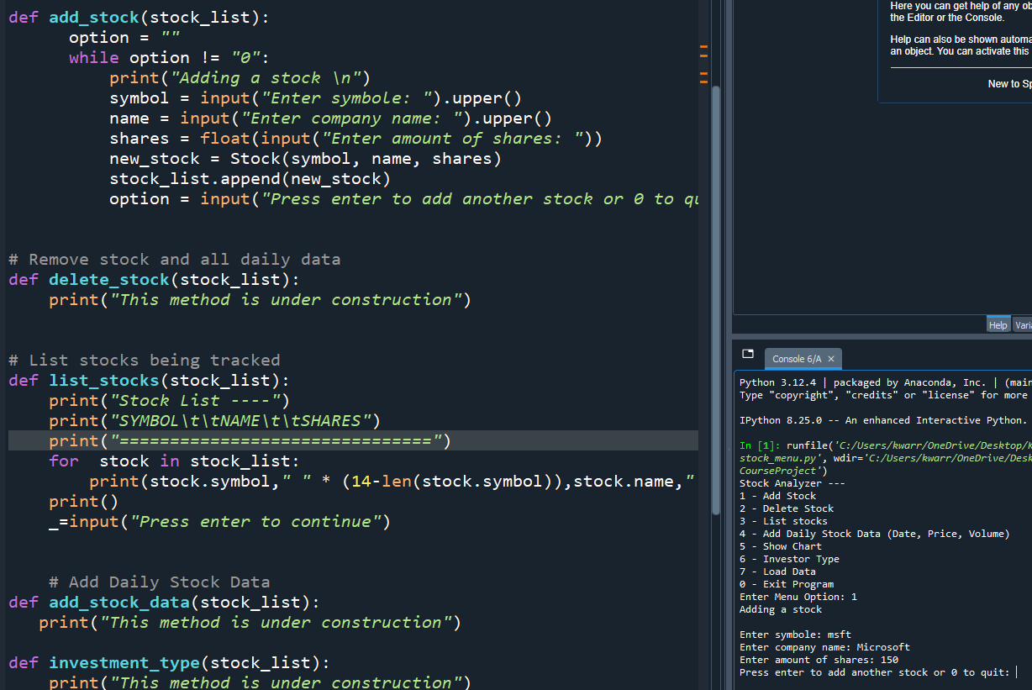
Adding a stock

Slide 11
Listing stocks

Slide 12
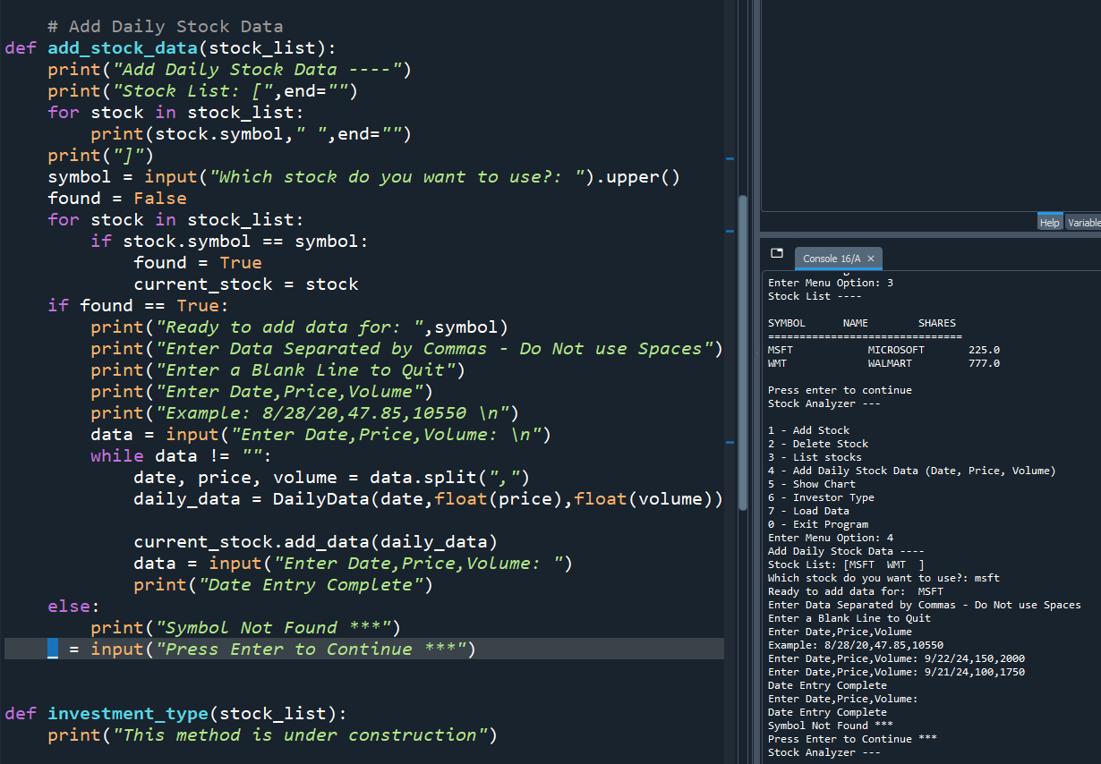
Daily data

Slide 13
interface & summary report – Module 4

Slide 14
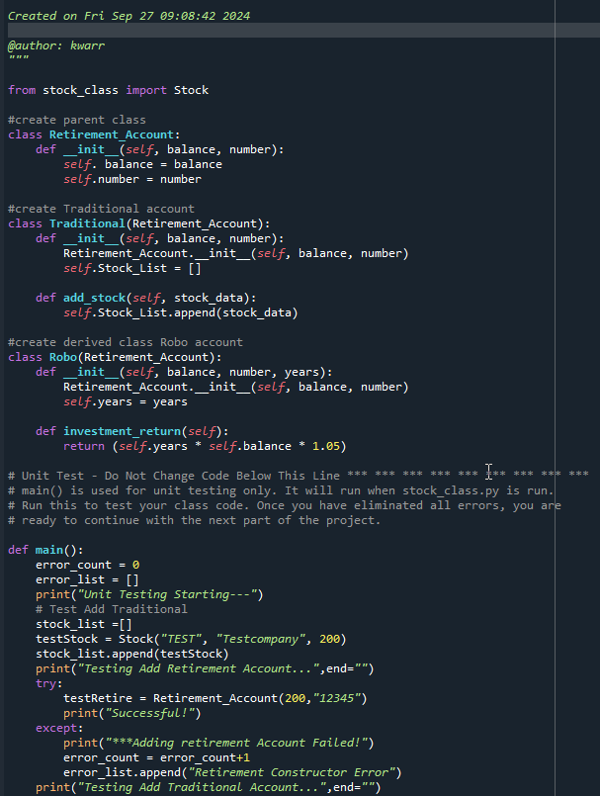
Inherited classes

Slide 15
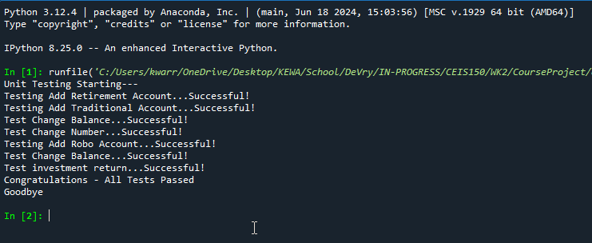
Unit test

Slide 16
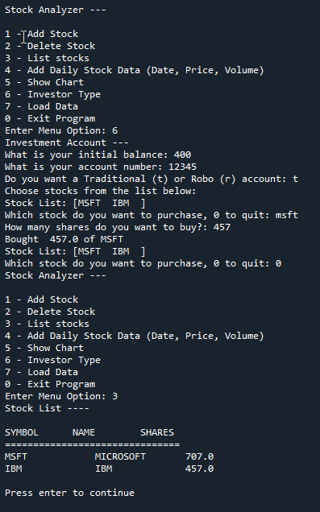
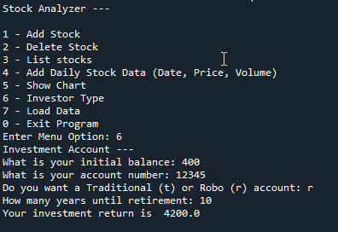
Stock menu program

Slide 17
Creating a Chart– Module 5

Slide 18
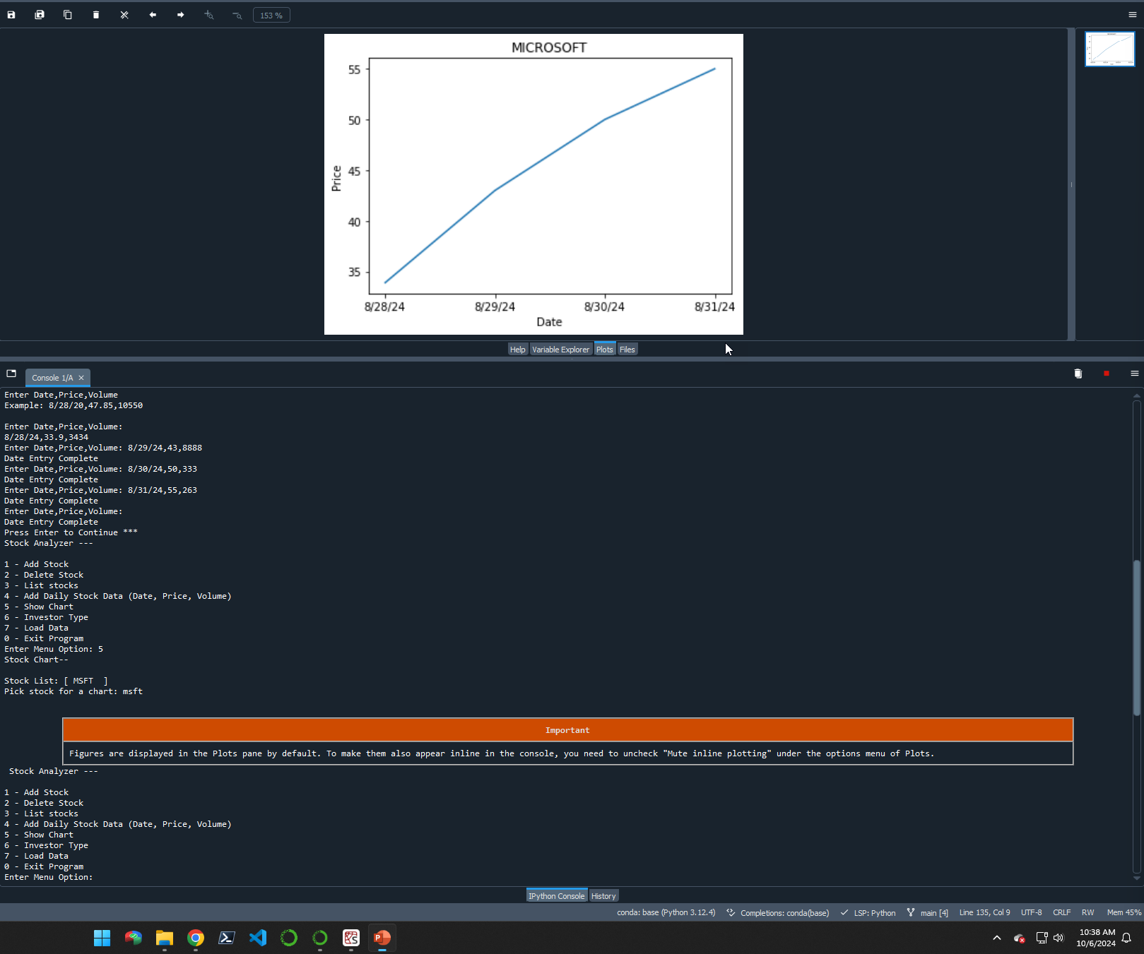
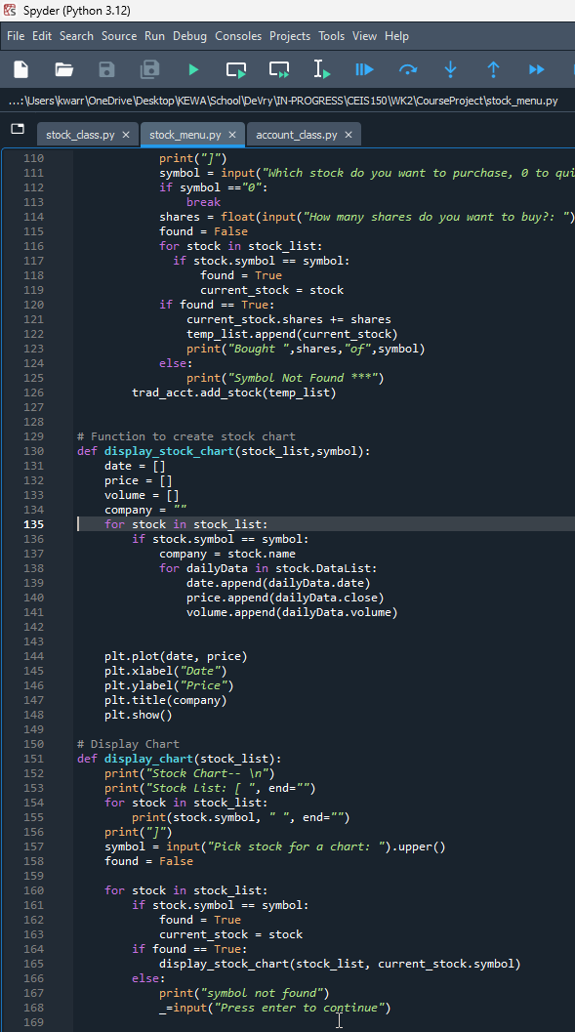
chart

Slide 19
Loading data from file – Module 6

Slide 20
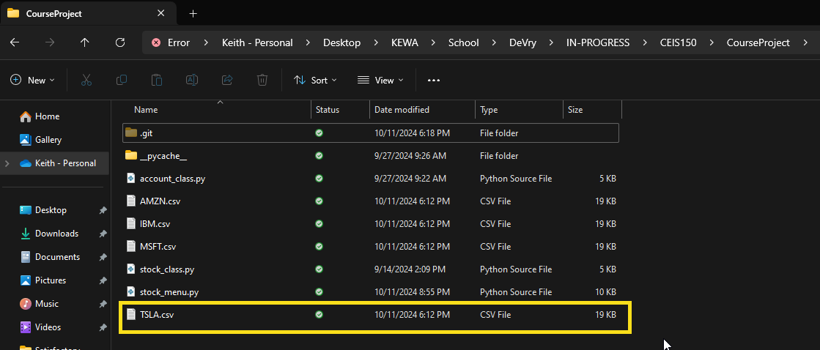
Downloading data file

Slide 21
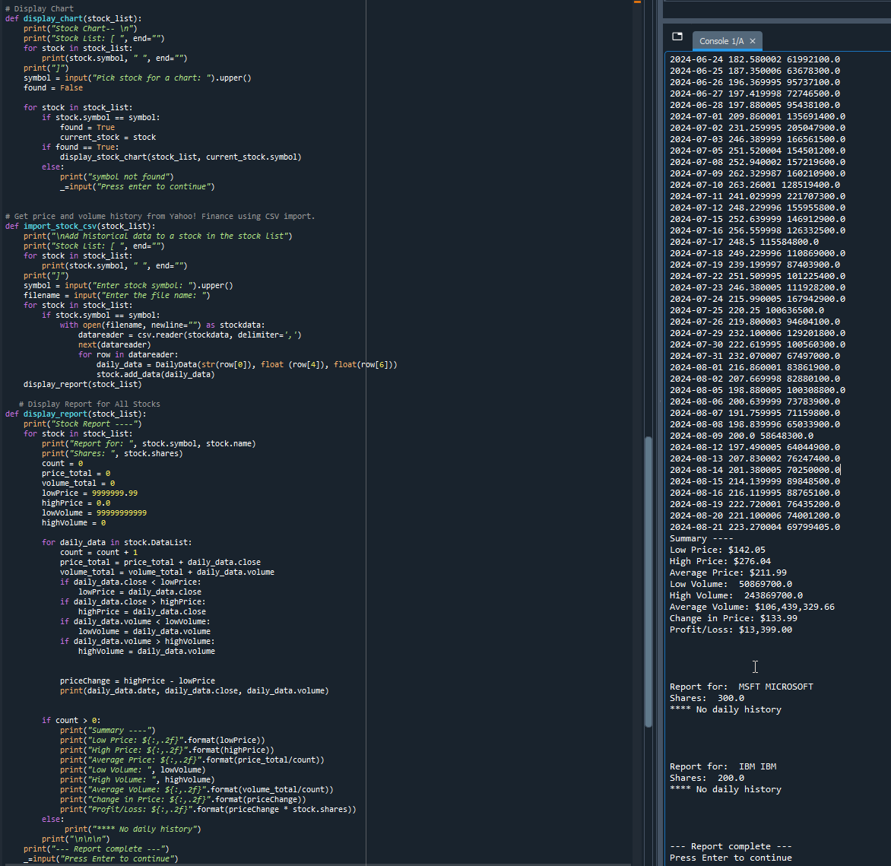
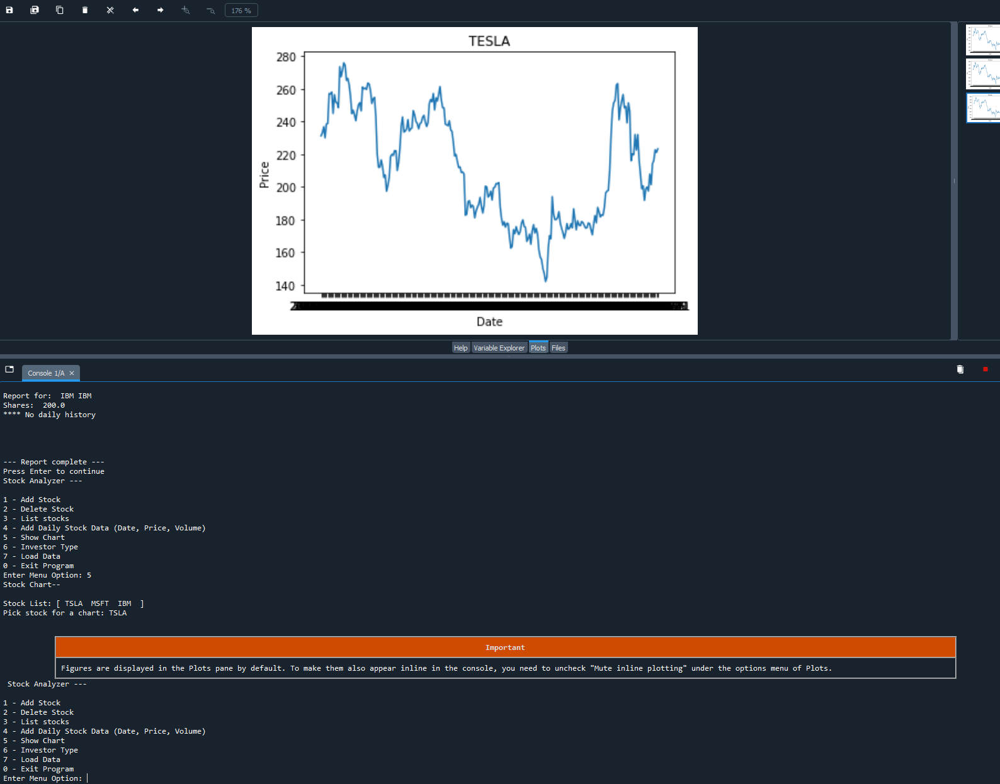
Importing data

Slide 22
Adding Graphical user interface (GUI) – Module 7

Slide 23
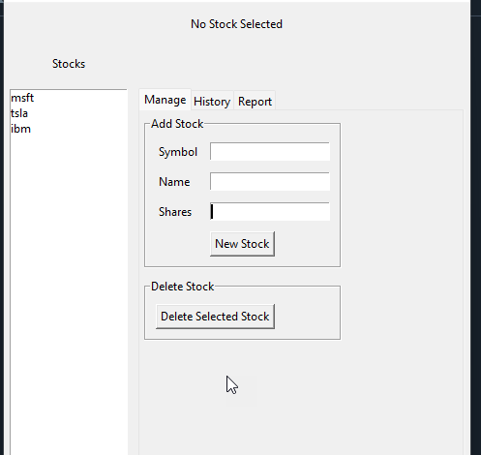
Stocks in gui

Slide 24
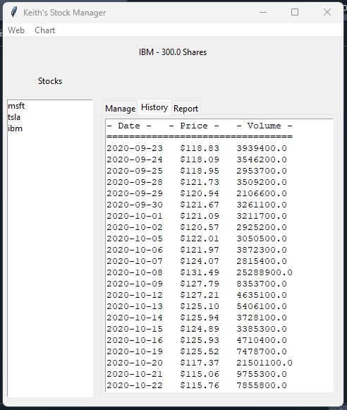
Imported data / history tab

Slide 25
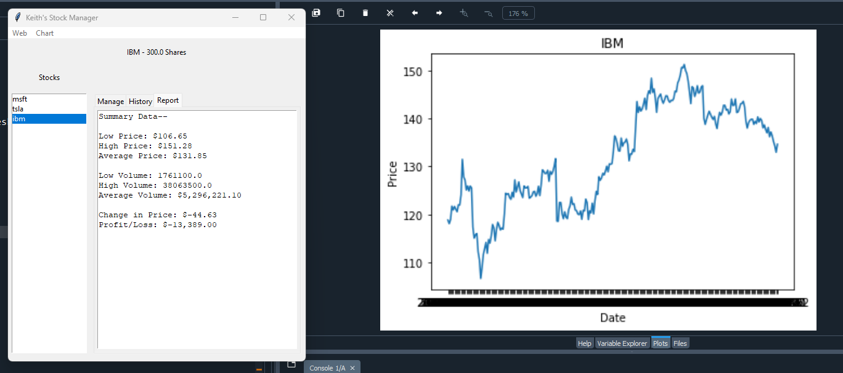
Report with graph

Slide 26
Career skills
Object-Oriented Programming in Python
Web Scraping / Data Manipulation
Python Libraries
Building a full fledge application with GUI interface

Slide 27
conclusion
This project provided me with hands-on experience in Python programming, focusing on object-oriented techniques to build a stock tracking application. By processing historical stock data, I was able to gain skills in data manipulation, analysis, and visualization using Python libraries. The project allowed me to interact with web sources for stock data retrieval, enhancing my web scraping abilities.

Slide 28
THANK YOU

